Slide 1

The National University of Computer and Emerging Sciences
Introduction to Course
CS 1002 Programming Fundamentals
Dr. Akhtar Jamil
Department of Computer Science

Slide 2
Instructor Information
Instructor | Akhtar Jamil | E-mail | akhtar.jamil@nu.edu.pk
Post Doctorate: Istanbul University-Cerrahpasa, Istanbul Turkey Ph.D. : Yildiz Technical University, Istanbul Turkey Specialization: Machine Learning / Computer Vision
Office | C-202 F | Tel | 111-128-128; Ext. 633

Slide 3
Meeting Hours
Schedule & Office Hours
Days | 08:30-09:50 | 10:00-11:20 | 11:30-12:50 | 01:00-02:20 | 02:30-03:50
Monday | PF | PF | Meeting Hours
Tuesday | PF |  | Meeting Hours
Wednesday | DIP | PF | Meeting Hours |  | Meeting Hours
Thursday | DIP |  |  | Meeting Hours
Friday

Slide 4
Course Materials
Will be shared via Google Class Room
https://classroom.google.com/c/NTI2NTQ5MTM4Nzk5?cjc=kts6kea
Class Code
kts6kea

Slide 5
Course Information
Credit Hours
Total credit hours = 4
3 credit hours of class lectures
1 credit hour of Lab (equivalent to 3 hours of Lab work)
Lab Instructors
BCS-1D Mr. Muhammad Usman Khan
BCS-1E Ms. Riva Malik

Slide 6
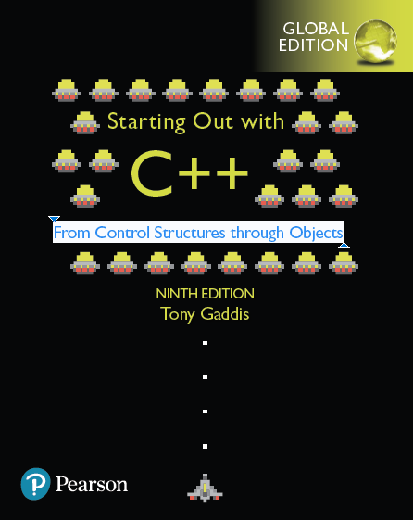
Text Book
Tony Gaddis "STARTING OUT WITH C++ From Control Structures through Objects" 9th Edition

Slide 7
Reference Book(s)
Paul Deitel, Harvey Deitel "C++ How to Program" 10th Edition
Walter Savitch "Problem Solving with C++" 10th Edition

Slide 8

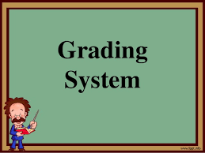
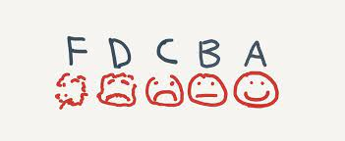
Grading Policy
Absolute Grading

Slide 9
Grading Policy
Assessment Item | Number | Weight (%)
Assignments | 4 | 12
Sessional - I | 1 | 10
Sessional - II | 1 | 15
Quizzes | >= 4 | 10
Project | 1 | 13
Final Exam | 1 | 40

Slide 10
Explanation of Assessment
All assignments and Quizzes carry equal weightage
Enough Time will be given for Assignments for their implementation
Quizzes can be announced or surprise
Project will be done individually

Slide 11
Environment Specifications
Operating System
Ubuntu 20.04 LTS
Code Editor
Text Editor
Compiler
G++

Slide 12
Work Environment Setup Requirements
Students are required to use the mentioned softwares/tools for their labs
It is obligatory to use only the specified development environment
Same environment will be used for attempting course assignment
Students are expected to setup the environment on their personal systems by the end of the week

Slide 13
Course Plagiarism Policy
Plagiarism in any kind of assessment including project or sessional/ final exam, assignments quizzes, will result in F grade in the course.
So what is it?
Plagiarism is presenting someone else's work or ideas as your own, with or without their consent, by incorporating it into your work without full acknowledgement. All published and unpublished material, whether in manuscript, printed or electronic form, is covered under this definition.

Slide 14
Dishonesty, Plagiarism
You can fool some of the people all of the time,
and all of the people some of the time,
but you can not fool all of the people all of the time.
Abraham Lincoln,
16th president of US (1809 - 1865)

Slide 15
Missed Assessment
Retake of missed assessment items (other than sessional/ final exam) is NOT allowed.
Missed assessment item (other than sessional / final exam) will earn zero marks
Late submission will NOT be accepted .
For missed sessional/ final exam due procedure will be followed.
No change is any deadline

Slide 16
Late Submission Policy
Penalties for late submissions of assignment/ project:
Up to 3 hours late, loss of 40% of the mark awarded.
After 3 hours, the assignment/project will not be accepted for marking.

Slide 17
Attendance policy
Students are supposed to have 100% attendance.
The minimum attendance requirement at all levels and in all courses is 80%.
The relaxation of 20% attendance has been given only to cover any planned events or unforeseen situations.
I will take attendance at the start of lecture
Anyone reaching after 10 minutes will be marked as Absent.

Slide 18

Class Policies and Guidelines
Use of cell phones
Discussion with fellows during class (unless needed for some announced task)
Early leave (will result in absent)
Frequent movement In-out during class
Be interactive, ask questions
Participate in the lecture
Relax and learn ☺

Slide 19
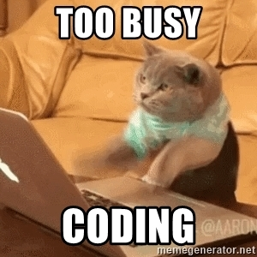
What is this Course About ?
Its about knowing computers
Programming them.
Assumptions: no prior knowledge of programming

Slide 20
Lab Work
Lab Instructors are to be consulted for Lab related issues.
Do not switch lab sections without asking permission from the lab instructors.
Laboratory attendance will be taken in each lab.
For queries related to Lab exercises or assignments, consult the lab instructors only.
The rules related to the labs will be announced in the laboratory session.

Slide 21
Goals of this Course
Provide basic computing concepts
Analyze the given requirements for solving real problems
Implement the solutions using computer program.
Developing algorithms and write code for them.
Understand basic programming constructs like control structures, arrays, functions, pointers, dynamic memory allocation.
Learn the syntax of the C++ programming language.

Slide 22

Course Learning Outcomes (CLOs)
After completion of the course, the students shall be able to:
Understand basic problem-solving steps and logic constructs.
Apply basic programming concepts.
Design and implement algorithms to solve real-world problems.

Slide 23
List of Topics
List of Topics | Weeks
- Problem-solving, Basic flowchart, block diagram, and programming languages. - Primitive data types, input/output (hello world). - Signed and unsigned data types, constants and variables. | 1
- Arithmetic operators (+, -, *, /, % and their compound counterparts) with their associativity and precedence. - Bit wise operators | 2
- Conditional/selection structures. - Comparison and logical operators. - if, if. . .else and if else if structure. - Switch statement, break statement. - Ternary operator. | 2
1st Sessional Examination

Slide 24
List of Topics
List of Topics | Weeks
- Repetition structures. - Pre/post increment/decrement operators. - while loop (sentinels + condition). - Loop with for. - Loop with do-while. - Nesting of while, for loop and continue statement. | 3
- Function prototypes, definition, and calling. | 1
- Introduction to Arrays. - Array initialization and representation. - Char arrays. - Multi-Dimensional Arrays (MDA). - MDA representation in memory. | 1.33
2nd Sessional Examination

Slide 25
List of Topics
List of Topics | Weeks
- Aliases, parameters passing by value and by reference (passing arrays). - Function calling order and stack (function within a function). - Recursion | 1.66
- Pointers. - const. vs. non-const. pointers, a pointer to const. data vs. a pointer to non-constant data. - Using pointers. - Dynamic memory allocation. - Array of pointers. | 2
- Header files (creating own file). - Files handling - Opening flags (app mode). | 1
Final Examination

Slide 26
Any Questions

Slide 27
Thank You ☺

